Slide 1
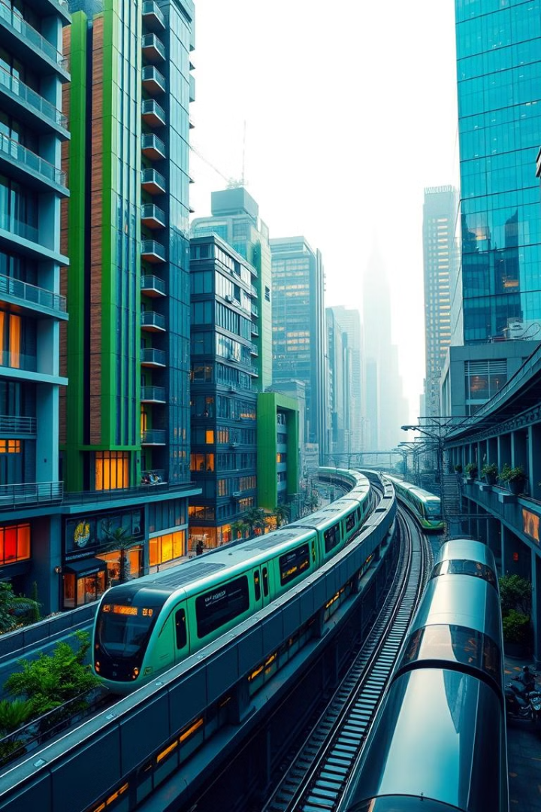
URBAN HARMONY:
Smart City Solutions Addressing Urban Challenges
This presentation explores innovative solutions to address key challenges faced by rapidly growing cities, focusing on transportation, population density, and slum development.

Slide 2
Affordable Travel Solutions
Dynamic Pricing
Capacity Optimization
Adjust ticket prices based on demand, time of travel, and occupancy levels.
Analyze passenger load and adjust train capacity to maximize efficiency.

Slide 3

Data Structures for Travel Solutions
Graph
Priority Queue
Represent train network with stations as nodes and routes as edges.
Manage ticket pricing dynamically based on demand and other factors.
Hash Table
Store real-time data about ticket prices, occupancy rates, and travel patterns.

Slide 4
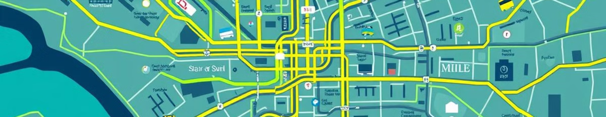
Improving City Connectivity
1
Network Optimization
2
Dynamic Scheduling
Use Dijkstra's algorithm to find shortest paths between stations.
Implement priority queues to manage train schedules based on demand.
3
Route Planning
4
Integration of Services
Use adjacency lists to represent connections between different transport modes.
Utilize graphs to represent multi-modal transport options (trains, buses, bicycles).

Slide 5
Managing Urban Population Density
Public Transportation Optimization
Traffic Flow Management
Implement Dijkstra's algorithm to optimize travel times across the city's train network.
Apply the A* search algorithm to find efficient paths for vehicles and alleviate traffic bottlenecks.

Slide 6





Controlling and Improving Slum Growth
Resource Allocation
Community Engagement
Utilize a priority queue to manage resources based on urgency and need.
Maintain a database of community feedback and suggestions.
Infrastructure Development
Integrated Housing Solutions
Implement the Bellman-Ford algorithm to find shortest paths for infrastructure development.
Utilize a hash map to manage housing applications, availability, and eligibility criteria.

Slide 7




Case Study: Mumbai vs. Bangalore
1
Population Density
2
Transportation Infrastructure, hill station
3
Urban Planning Strategies
4
Slum Development
Compare Mumbai's effective population management with Bangalore's traffic challenges.

Slide 8

Key Takeaways
Data-Driven Solutions
Integrated Approach
Leverage data structures and algorithms to optimize urban systems.
Address urban challenges holistically, considering transportation, population, and development.
Community Engagement
Involve residents in planning and decision-making processes.

Slide 9




Next Steps
Pilot Projects
Implement pilot projects to test and refine solutions.
Data Collection
Gather data to monitor progress and identify areas for improvement.
Stakeholder Collaboration
Engage with government agencies, businesses, and communities.

Slide 10
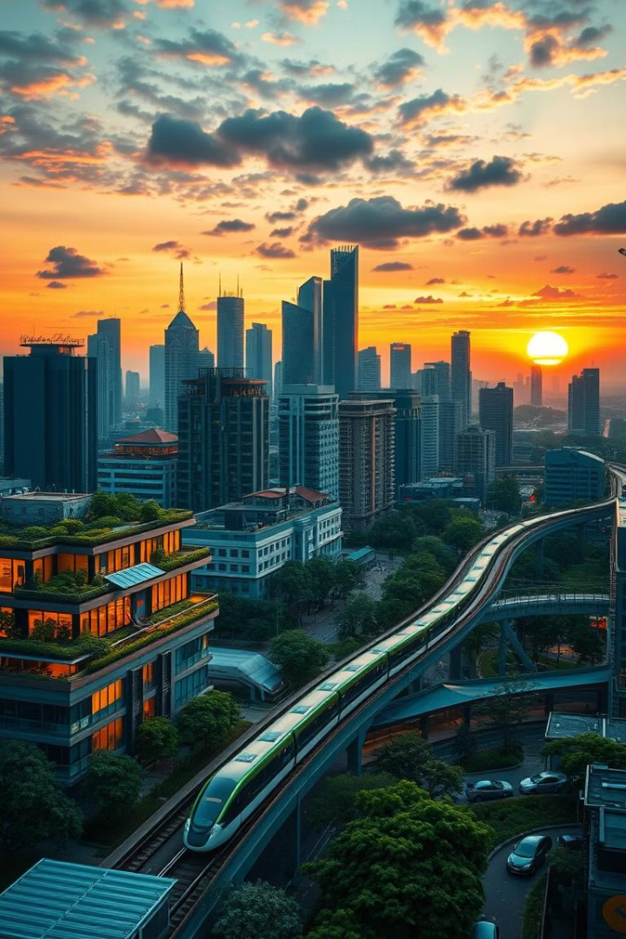
Building a Smarter Future
By embracing innovative solutions and collaborative efforts, we can create smarter, more sustainable, and equitable cities for all.

